Slide 1


SAP FULL-STACK DEVELOPER TRAINING
ABAP on HANA, UI5 & Fiori, Analytics with OData
Anubhav Oberoy
Day – 2

Slide 2

Agenda – Day 2
Sample Application
Components of an UI5 application
Introduction to MVC architecture
Views in SAP UI5
Controller in SAP UI5
XML Views
--Break--
Hook Methods in SAP UI5
Concept of Multiple Controllers
Models in SAP UI5
Control Hierarchy

Slide 3

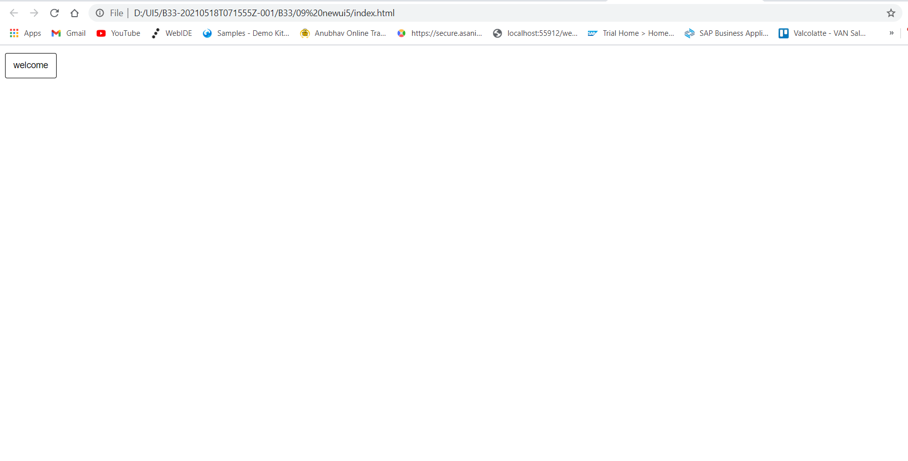
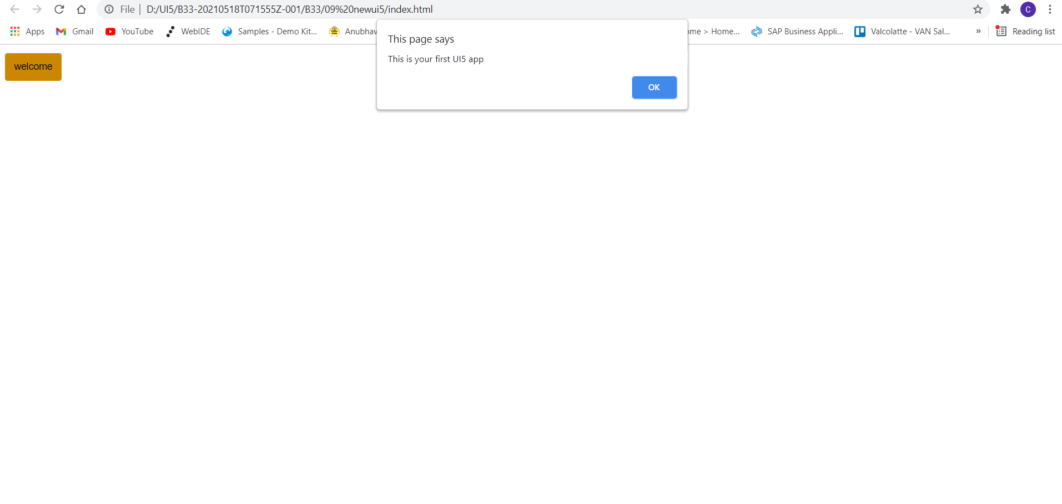
Sample SAP UI5 Application
Now we will make a sample UI5 application using index.html file.
In this application we are going to add a simple button provided in SAP UI5.
When the button is pressed it shows a alert popup at the top.
The application page looks similar to one which is shown below.
Code link:
index.html

Slide 4
Components of an UI5 Application
The UI5 framework is built on top of open standards like HTML5, CSS, JS, and jQuery. We use MVC architecture to create applications using SAPUI5.
BAS
App
Developer
SAP UI5 Design Time Component
SAPUI5 Runtime Component
HTML+CSS+JS
sap.m
sap.ui.comp
sap.ui.table
sap.ui.layout
Renderer
sap.ui.core
sap.ui.unified
sap.ui.core.mvc
HTML5
CSS
JS
jQuery

Slide 5
Introduction to MVC Architecture
MVC stands for Model, View, Controller.
Model:- The model component is a freely composed class that will keep the application data and do manipulations on it. All database accesses are done within the model.
View:- The View is responsible for defining the user interface to users. When a user sends a requests from his device, the view is responsible for data view as per the request submitted.
Controller:- The Controller is used to control the data and view events as per user interaction by updating the view and model.
<event>
Processing
Controller
eventHandler
<notifies>
<done>
<modifies>
I/O
View
Data binding
Data
Models
MVC Architecture

Slide 6
Views in SAP UI5
View is responsible to manage information display to the users.
Views are based on Model.
There are Four types of views in SAP UI5, these are listed below:
XML View:- It is in the XML format. The file name ends with the extension “.view.xml”. There are no predefined methods in the XML view.
JS View:- It is in JavaScript format. The extension of the view file is “.view.js”.
JSON View:- It is in JSON format. The file name ends with the extension “.view.json”.
HTML View:- It is in HTML format. The file name ends with the extension “.view.html”. Here we create the controls within the <div> tags, as we do while developing HTML pages.
Percentage Usage of Views:
2%
99%
JOSN View – 0%
HTML view – 0%
JS View is used only in 2% of the views.
XML Views are the mostly used views now a days.
The use of JSON and HTML views are negligible

Slide 7
Controller in SAP UI5
A controller contains methods that defines how models and views interact.
You define a simple controller as follows:
sap.ui.define([ "sap/ui/core/mvc/Controller" ],
function(Controller) {
"use strict";
return Controller.extend(“Address of Controller", {
// controller logic goes here
});
});
Special Class which inherits from standard SAP module called sap/ui/core/mvc/Controller
Skeleton of any JS file in SAP UI5 – Considered as a class
sap.ui.define([“dependencies”, “dep2”, “dep3”],
function(oD1, oD2, oD3) {
--logic—
}
);
Modules

Slide 8
Basics of Controller
For every Control if there is a property, we will have setter and getter methods for that property. For example, if there is a enabled property, we will have setEnabled and getEnabled methods.
To access the methods and properties of a UI Control, We cannot use the document object which is a plain HTML element object.
To obtain UI5 element object, we need to first get Application object,
sap.ui.getCore()
On top of App object, we can get UI5 element object and finally
byId(“just pass ID”)
we can call any methods of UI5
For every event in UI5, we have attachEvent, detachEvent, fireEvent methods as well, which can be used to link, delink and trigger event programmatically.
When we use JS view, inside the event handler, this pointer will point to the current control object not the class (controller) object. In order to force this pointer to work like our Controller object, we need to pass it explicitly. This ONLY applies in JS View.
Just now you showed getting view object from controller, this.getView(), Using this view object also can I get my control objects? Just to avoid sap.ui.getCore() – You can but in XML View
When we use XML views, the ID of the control will be viewId--controlId

Slide 9

Exercise 1
In this exercise we will create a js View.
Adding some buttons and input field in the view.
On Button press showing a alert popup
Exercise Code:
index.html
Main.controller.js
Main.view.js

Slide 10
XML View
What is XML?
XML stands for eXtensible Markup Language, it was originally developed to move data from one to another technology. It became popular to communicate between heterogeneous technologies.
XML is a tree data structure. Unlike HTML, we can use custom tags. Every programming language must support XML.
Portal
Java
App
ABAP
If_ixml
xml
xml
Data Objects → XML – Rendering
XML → Data Object - Parsing

Slide 11
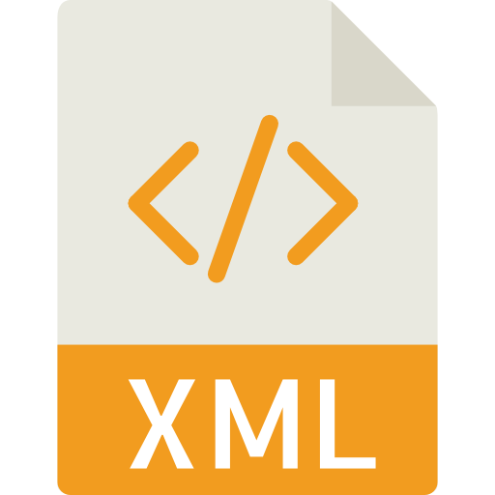
Structure of XML
<data>
<empStr>
<empId>5000</empId>
<empName>Jack</empName>
<salary>9500</salary>
<currency>EUR</currency>
</empStr>
<empTab>
<row>
….
</row>
</empTab>
</data>
Root Element
Child Element of <data> tag
Child Element of <empStr> tag
Skeleton of XML View
<core:View xmlns:core=“sap.ui.core” xmlns=“sap.m” controllerName=“pathOfContro.”>
<Button text=“Click Me”></Button>
</core:View>

Slide 12

Exercise 2
In this exercise we are going to create an xml view.
Adding a button and a form control in the view.
Exercise Code:-
MyXML.view.xml
MyXML.controller.js
Index.html

Slide 13

Break

Slide 14
Hook Method
onInit()
onBeforeRendering()
It is a function which gets called immediately after UI5 creates the object of our controller. It is like constructure of a class. We can use this to initialize our class variable
It is a method which gets called MULTIPLE times, Before every time the view is displayed to the user. This is similar to PBO of a screen. We can use this method for pre-processing on a view.
IN
BR
EX
AR
onExit()
onAfterRendering()
It is a function which gets called before the instance of our controller gets destroyed. It is like destructor of a class.
We can use this to write clean-up code.
It is a method which gets called MULTIPLE times, After every time the view is displayed to the user. This method can be used to show effects to the user.

Slide 15
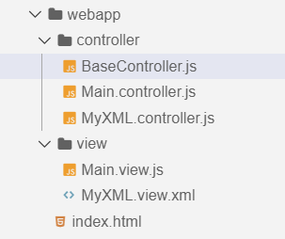
Concept of Multiple Controllers
Base Controller:- A base controller is a controller with basic functionalities from which the other controllers in your SAPUI5 application inherit.
The base controller holds basic functionalities that are used across multiple controllers.
The base controller itself is just another JavaScript file and it does not have the .controller prefix. Just BaseController.js and not BaseController.controller.js.
The base controller goes in the controller folder in your SAPUI5 application folder structure:
sap/ui/core/mvc/Controller
x
BaseController
Template
x
Controller 1
x
Controller 2
x
Controller 3
x
Controller 4
View 1
View 2
View 3
View 4

Slide 16

Exercise 3
In this exercise we will create a BaseController.
And we will get to know how our hook methods work.
Exercise Code:-
MyXML.view.xml
MyXML.controller.js
BaseController.js

Slide 17
Models in SAP UI5
The various model types supported by SAPUI5 are:
OData model
JSON model
XML model
Resource model
Each model in SAPUI5 is mainly used to bind controls to the data brought in. The JSON model is a client-side model which is recommended for datasets with small amounts of data.
Usage of Models:
%
100
100
100
95
80
Usage in Percentage
60
40
40
20
Models
OData
JSON
XML
Resource

Slide 18
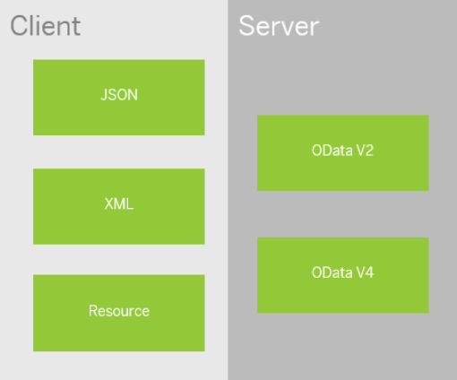
Model Basics
All the models in SAP UI5 are characterized in two different parts:
Client Side Model: -
A model which keeps all the data in the browser. We use client side model for manipulating data (like internal table).
Server-Side Model: -
Keeps data on server side, and ON-demand, it is loaded by client using the server side model.
We can use the APIs (Methods) provided by SAP to access data from model
We need to get model object using methods
getModel(modelName)
setModel(modelName)
From model object we get access to the data using methods
setProperty(sPath, sValue)
getProperty(sPath)

Slide 19

Steps to Create a Model
3 Easy Steps to Create a Model
Step 1: Create a brand new object of the Model
To Create JSON Model - var oModel = sap.ui.model.json.JOSNModel()
To create XML model – var oModel = sap.ui.model.xml.XMLModel()
To create Resource model – var oModel = sap.ui.model.resource.ResourceModel()
To create OData Model – var oModel = sap.ui.model.odata.v2.ODataModel()
Step 2: Set or Load the data in the Model
oModel.setData({});
oModel.loadData(filePath);
Step 3: Make the model aware to the application/view
sap.ui.getCore().setModel(oModel);
this.getView().setModel(oModel);

Slide 20
How to Address Model Properties?
In the json data we can make address as “Every curly braces is converted to / and every array item is converted to /index”.
{
"empStr": {
"empId": 0001,
"empName": "Anubhav",
"salary": 8000,
"currency": "USD"
},
"empTab": [{
"empId": 0009,
"empName": “Ananya",
"salary": 9500,
"currency": "USD“
}, {
"empId": 0010,
"empName": “Shwetha",
"salary": 10000,
"currency": “EUR"
}]
}
Q: what is the salary of Anubhav
/empStr/salary
Q. What is the emp name of emp 0001
/empStr/empName
Q. What is the salary of Shwetha
/empTab/1/salary
Q. What is the empId of Ananya
/empTab/0/empId

Slide 21

Exercise 4
In this Exercise we will create a JSON Model in the controller and bind it to the form fields.
Exercise Code:-
MyXML.view.xml
MyXML.controller.js
Exercise 5
In this Exercise we will create a folder named model in the our webapp folder and create a demo data files and create a model.js file to initialize the model
Exercise Code:-
MyXML.view.xml
MyXML.controller.js
sample.json
data.json
Model.js

Slide 22
Control Hierarchy
sap.ui.base.ManagedObject
Syntax to create object
var oName = new libraryName.ControlName({
prop: Val,…
});
Note:- Whenever we see a control, and if we are unable to find a property, association, event or function in that class, check its parent class.
sap.ui.core.Element
sap.ui.core.Control
sap.m.Button
sap.m.InputBase
sap.ui.view
sap.m.Table
sap.ui.layout.form
sap.m.Input
SimpleForm
sap.m.Column
Some of the Frequently used controls in SAP

Slide 23

End of Day 2

Slide 24

Questions

Slide 25

Anubhav Oberoy

Slide 26


We’re committed to empower you to be
Most Desirable Resource
through powerful training solutions.
We build the workforce of the future.
250+
Corporate Clients
30,000+
Learners Trained
25000+
Learners Placed
FREE WEBINARS
Sign up for free webinars with industry experts every fortnight!
Enroll Now!
Contact us today!
https://anubhavtrainings.com/

Slide 27




More from AnubhavTrainings.com

Slide 28
Title
Content

